Slide 1

Jamaica Plain Violence Intervention and Prevention Collaborative
MassHousing’s Annual Community Services Conference
10 June 2011

Slide 2
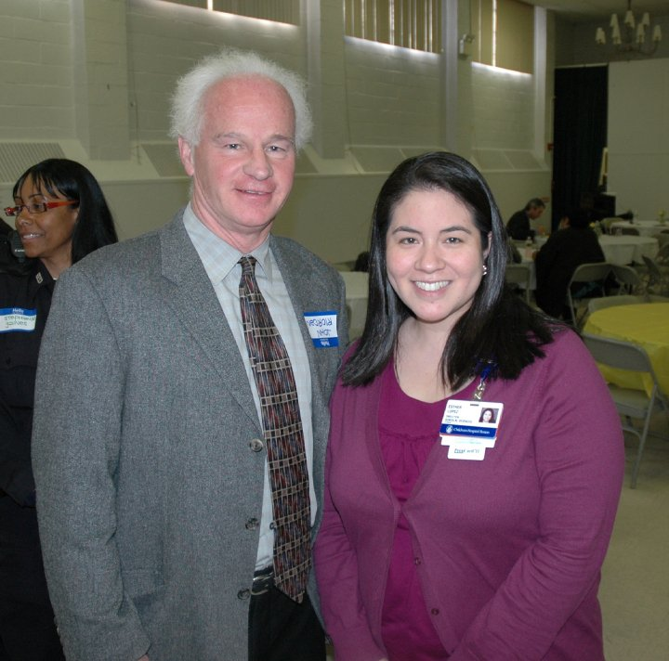
Overview
In 2007, prompted by an outbreak of 13 shootings in 15 weeks, The Academy/Bromley/Egleston Public Safety Task Force responds to outbreak of community violence.
Before engaging in prevention activities, participants felt compelled to respond to the trauma that community residents were experiencing. Hence the creation of the Trauma Response Team.

Slide 3
Initial Focus & Findings
A meeting to engage broader community in response to violence was convened in which 90 community leaders attend and pledge support
From this meeting15 community agencies, including 4 community health centers and 3 public housing developments, agreed to work together to address the violence
Identifies lack of community mental health resources as a significant contributor
TRT contracts trauma expert to conduct “Psychological First Aid” training
TRT begins responding to incidents of community violence
Participants focus on supporting impacted families

Slide 4







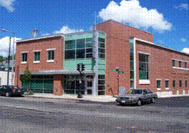



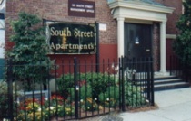



Collaborative Members
Academy Homes Housing Development
Boston Public Health Commission
Bromley Heath Housing Development
Brookside Community Health Center
Children’s Hospital Boston
Dimock Center
ESAC
Family Services of Greater Boston
Hyde Square Task Force
Martha Eliot Health Center
MassHousing
Southern Jamaica Plain Health Center
South Street Housing Development/Youth Center
Spontaneous Celebrations
Urban Edge
West Roxbury Court

Slide 5
Collaborations
Academy Bromley Egleston Safety Task Force
Bikes Not Bombs
Boston Medical VIP
Boston Police Department
Boston Street Workers
Bowdoin Street VIP
Brigham & Women’s Hospital
Center for Homicide Bereavement
Curley Middle School
English High School
Greater Love Tabernacle Church
Grove Hall Youth Workers Alliance
High Risk Youth Network
JP Unidos/United
Judge Banks Community Justice Program
Louis D. Brown Peace Institute
MassHousing
Office of Child Advocacy
Project RIGHT
St. Peter’s Church/School
South End/Lower Roxbury Youth Workers Alliance
Street Safe Initiative
Teen Empowerment
Upham’s Corner Health Center
Upham’s Corner VIP
Youth Health Equity
Youth Political Action Committee

Slide 6
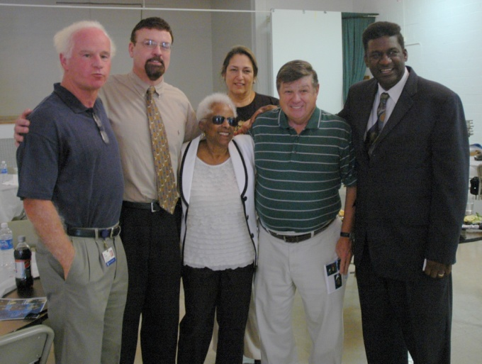
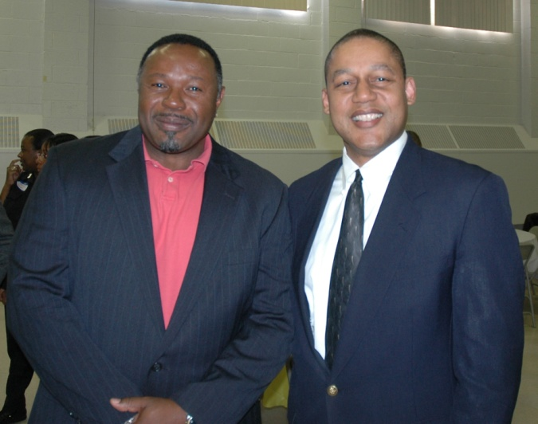
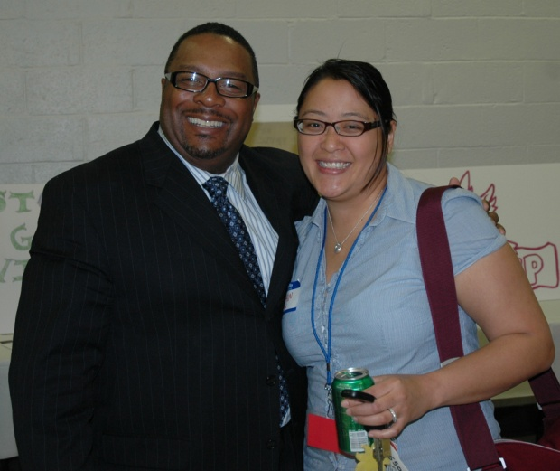
Initial Funding
Boston Foundation
Boston Public Health Commission
Children's Hospital Trust
Highland Street Foundation
MassHousing
Office of Child Advocacy

Slide 7
Staffing
In 2009, The Collaborative attracts funding to hire key staff members
  Project Coordinator to:
    Coordinate TRT response in immediate aftermath: post-vention
    Track/intervene on anniversaries & other “flash points”: intervention
    Identify and coordinate initiatives to prevent violence: prevention
  Resource Specialist to prevent further violence by connecting directly-impacted families and other at-risk families with services
  Outreach Worker to prevent violence by engaging youth in positive youth development activities

Slide 8
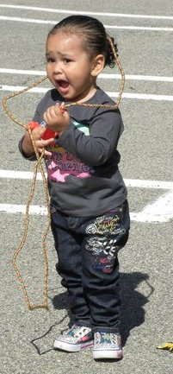
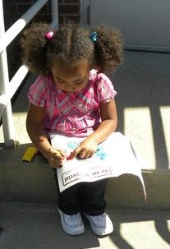
Mission and Vision Statement
(Established July 2010)
The mission of the JP VIP Collaborative is to help youth and families of Jamaica Plain and neighboring communities to live safe and healthy lives by collaboratively providing access to and education about mental health services, identifying available resources and responding to families affected by violence.
The vision is to create a peaceful environment for youth and families living in Jamaica Plain and neighboring communities to live, work and play

Slide 9
Open Incidents & Trauma Response
Trauma Response
Mobilize people and teams to respond to family and friends affected by any violent incidents that occur in the JP community. Response includes assistance with legal or police matters, assist in funeral arrangements, and provide psychological first aid to those affected.
Open Incidents
Keep track of incidents and follow-up activities, including anniversaries (of the violent incident) and other significant dates, to maintain a proactive engagement with families and friends of victims and reduce the likelihood of flare-ups of violence.

Slide 10
Acknowledgements
The Trauma Response Team:
  Model Program
    Was recognized as a “Model” community response to trauma by the Boston Public Health Commission and awarded a $25,000 grant to formalize the TRT’s protocol and practices
  City Council hearing
    Invited to testify at a City Council hearings in 2009 & 2010 by councilors interested in replicating TRT work citywide.
  Incident Response
    The TRT responded to 70 incidents, including coordination of on-site assistance to families and friends of victims in the immediate aftermath of an incident, assistance with making funeral arrangements, attending funerals, and connecting families with mental health services.
Note: TRT expanded the focus from trauma response to include prevention and renamed the Trauma Response Team (TRT) to the Jamaica Plain Violence Intervention ad Prevention (JP VIP) Collaborative.

Slide 11
Violence Initiative Goals
Post-vention: Trauma Response
Goals:
Improve community capacity to respond to violence by providing “Psychological First Aid” training
  Promote healing among families directly affected by violence by connecting them with services at local health centers and through The Online Advocate
However light-hearted you try to be about it, the loss of youth, and everything that goes with it, is quite a trauma. Julian Clary

Slide 12

Violence Initiative Goals
Intervention
Goals:
Reduce incidents of retaliatory violence by tracking anniversaries of incidents and planning interventions that focus on healing rather than revenge
Reduce the stressors that contribute to violence by connecting at-risk families with services at local health centers and through The Online Advocate

Slide 13
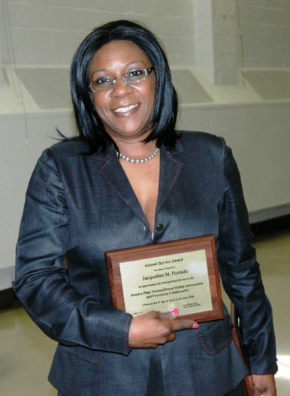
Trainings
Psychological First Aid
90 community agency representatives and residents, 11 youth workers, and 30-40 clinicians in (totaling 145 individuals trained)
Youth Suicide Prevention
15 health center providers and youth workers trained
Homicide and Bereavement
10 clinicians
Trauma Systems Therapy
20 clinicians
Domestic Violence
30 community, resident and health care professionals

Slide 14
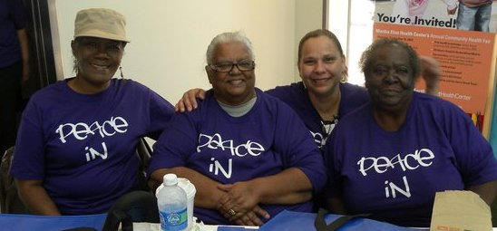
Violence Initiative Goals
Prevention
Goals:
Prevent participation in violence by engaging youth in developing alternative activities

Slide 15
2009 Accomplishments
15 health center providers and youth workers trained in youth suicide prevention
10 clinicians received training on homicide and bereavement
20 clinicians to be trained in Trauma Systems Therapy
Collected 126 “Peace Pledge Signatures” during the Martha Eliot Health Fair
Outreached (Direct Contact) to 30 people/ 12 People needing Case Management
Participated in 16 Trauma Responses (including stabilization, memorial, wake and funeral attendance, court appearance, and mental health referrals)

Slide 16
2009 Accomplishments cont.
Developed Open Incident Process
Completed Needs Assessment/Evaluation of all partners
Developed Training (including Post Training) Programs
Participated in 22 Professional Development Opportunities
Instituted an organizational structure for the TRT that includes a Steering Committee, Training Committee, Open Incident Committee
Drafted a Trauma Response Incident Command Structure and Protocols document

Slide 17
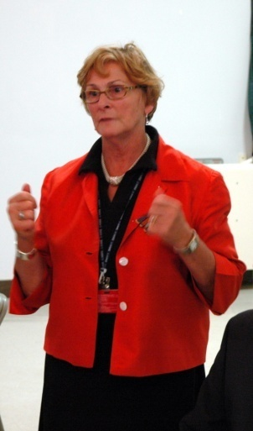
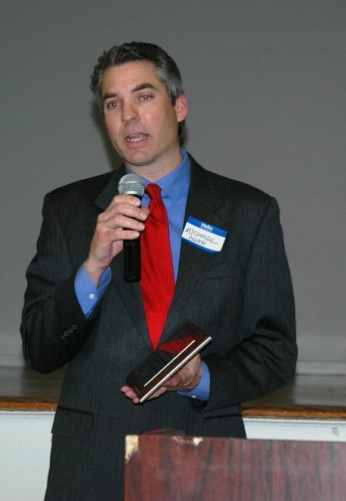
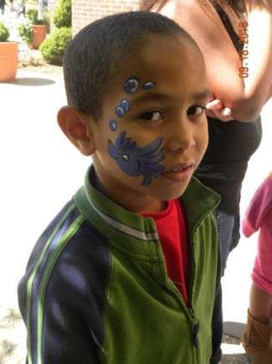
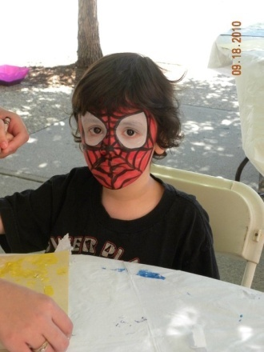
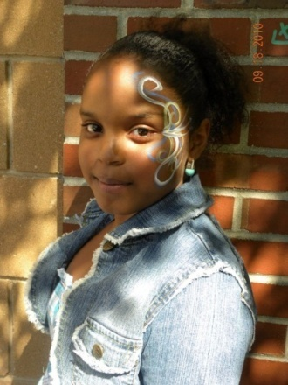
2010 Accomplishments
Spanish version of The Online Advocate Completed
158 Individuals Completed The Online Advocate
Focus Groups with South Street and Academy Youth
60 Youth participated
30 Online Advocate completions
Developed a Trauma Response Incident Command Structure and Protocols Documents

Slide 18
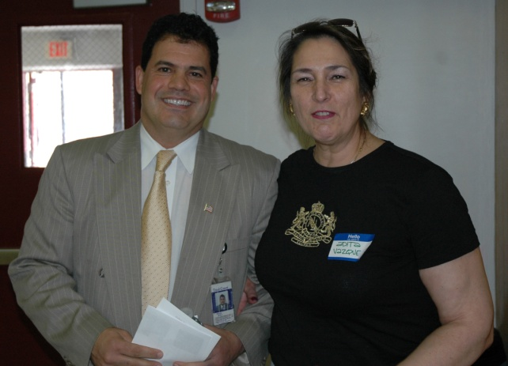
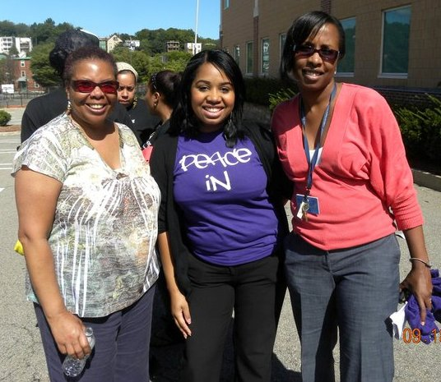
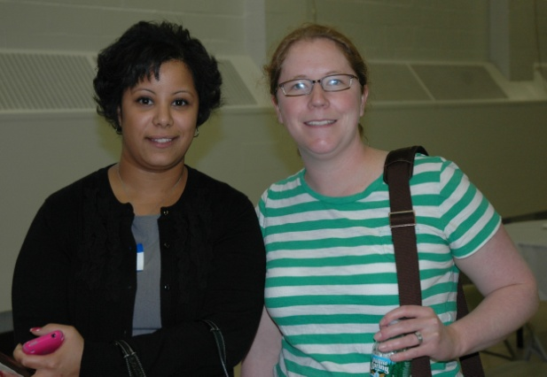
2010 Accomplishments cont.
Community Trainings/Forums
Suicide Prevention Training
Citizen’s for Safety/Traffic Jam Workshop
DV Presentation with Shannon Booker (Framingham 8)

Slide 19
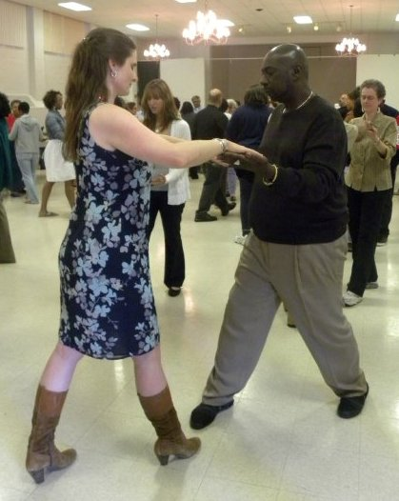
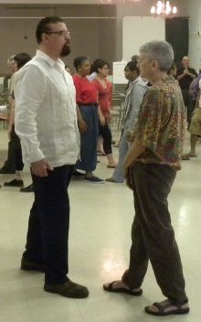
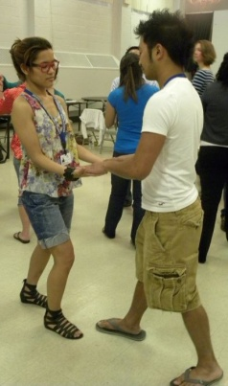
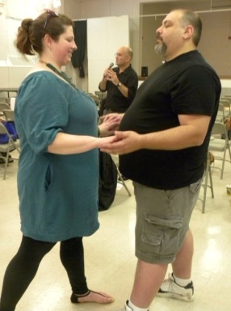
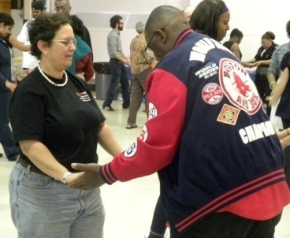
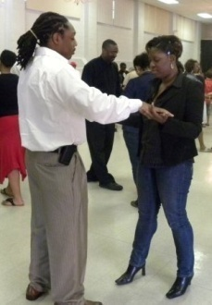
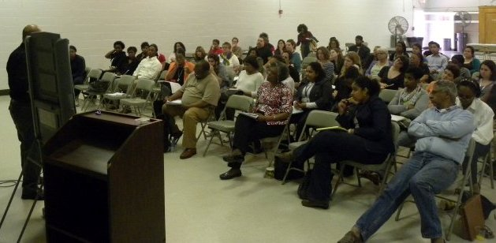
2010 Accomplishments cont.
Community Trainings/Forums cont.
Homicide and Bereavement
10 Clinician were trained
Domestic Violence Panel & Workshop
Bay State Banner did coverage article
Vivencia – Non-violent Communication

Slide 20
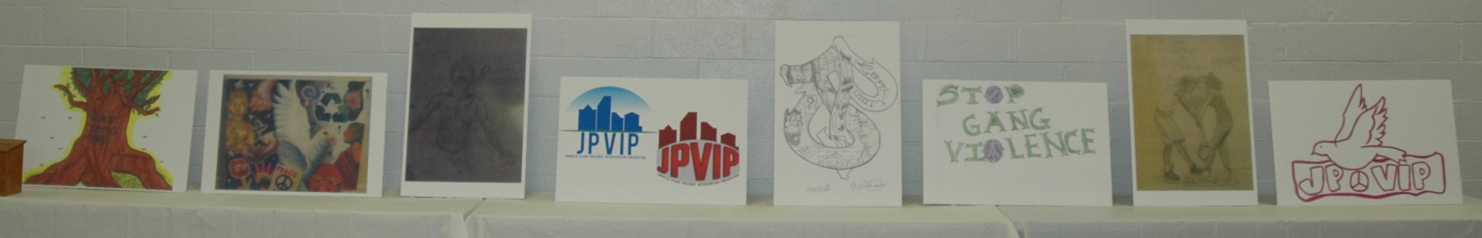
2010 Activities
Community Appreciation Luncheon
60 people in attendance
8 Recognition Awards presented
8 Service Awards presented
Logo Contest and Design
1st Place Winner (Ivan Ritchiez)
2nd Place Winner (Mario Sanchez)
3rd Place Winner (Julio Rodriguez)

Slide 21
2011 Goals
1
To provide education, information, and resources related to mental health to youth and families in Jamaica Plain.
2
Develop a relationship around trauma prevention and intervention with Boston Public Schools in the JP Community.
3
Develop a youth strategy that will engage youth in the JP VIP Collaborative’s work and empower them to reach out to other youth.
Each of the identified goals has objectives, activities and measureable outcomes that will demonstrate the progress that the Collaborative has made at the end of the year.

Slide 22
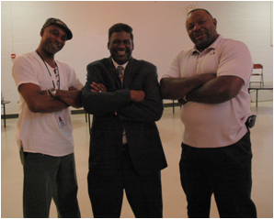
Personally and professionally this collaboration has been a learning experience. It has taught me the importance of support and how there is strength in numbers…” - Pamela Gillard, The Dimock Center
The team is a wonderful tool for our organization…” - Jacque Furtado, Bromley Health
“For me The Collaborative has inspired my total outlook and understanding of the traumatic aspects that happen in my community and with me personally” - Annie Russell, New Academy Estates.
As a person that studies crime prevention on a national level I can say this program is a model for many cities across the US. True partnership, community leadership with positive real expected outcomes are the key elements of this program.” – Thaddeus Miles, MassHousing

Slide 23
Project Process Chart
( DRAFT)
1 Trauma Response
Coordinator and
Incident Commander
Youth Workers
/Peer Leaders
2 Street Workers/
Community Outreach
Peer Leaders
Jamaica Plain
Mental Health
Violence Prevention
and Intervention
Collaborative
1 Social Worker
(Brookside Community
Health Center)
1 Social Worker
(Dimock Community
Health Center)
Domestic Violence Coordinator
1 Social Worker
(Martha Eliot
Health Center)
1 Social Worker
(Southern JP Community
Health Center)
2 Resource Specialists
Case Managers
( Housing Developments:
1 Bromley Heath
& Academy Homes;
1 - TBD)

Slide 24
Model
Traumatic Incident*: Homicide or Suicide of someone who lives, works or plays in JP/Roxbury
City-wide Trauma Response Network: BPHC, Street Workers, Louis D. Brown, etc.
Info given 24/7, by member of team or anyone in the community
Within 72 hours
Within 5-10 hours convenes IRT or at noon the next day
Aftercare Response Team- Recovery Support
JPVIP Trauma Response Coordinator (Incident Commander)
Immediate Response Team
Family Liaison (can be same person or different from immediate responder)
Mental/behavioral health liaison (family PCP, social worker, other clinician or someone who has connections with behavioral health services)
Youth worker (there to find resources other than behavioral health, for any young people in the family system)
Family Liaison (should be connected through someone who knows them)
Logistics (supports/coordinates activities around funeral)
Communications (speaks with rest of TRT, media makes sure we are not duplicating work)
City-wide representative (keeps this response connected to the larger system so as to maximize resource and limit duplication)
Other
Other Resources
*Any Traumatic Event

Slide 25
Youth Employment
In the US:
40% of white teens ages 16-19 were employed in the summer of 2008 compared to 26% of Hispanic teens and 20% of Black teens.
ABCD’s SummerWorks program 2008:
2,689 youth applied for jobs through the program, and 1,041 received employment
Youth earned $8/hour and worked 20 hours a week, earning an average of $987 for the summer, which represented 8.95% of their families’ total income for the year
“Employment and ennui are simply incompatible” Madame Deluzy

Slide 26
Youth and Young Adult Population in Jamaica Plain
(2000 stats)

Slide 27
Racial and Ethnic Makeup Jamaica Plain
(2000)

Slide 28
4-year Graduation Rate
Grades 9-12 Boston
(2010)
“If you think education is expensive, try ignorance! “ Andy McIntyre

Slide 29

Boston Homicides
Homicides
January 1 – June 5 | 2010 | 2011
Jamaica Plain | 2 | 1
Boston | 26 | 14
TOTAL | 28 | 15

Slide 30
Youth Violence
United States Statistics
> 656,000 violent acts involving youth ages 10 to 24 in 2008
5,764 homicides (2010) – average of 16 per day
Homicide is the #2 leading cause of death for Youth 10-24 years)
#1 leading cause of death in African American youth
#2 leading cause of death in Hispanics youth
Of the homicide victims - 86% were male and 14 % were females
Among homicide victims – 84% were killed with a firearm
“Violence among young people is an aspect of their desire to create. They don't know how to use their energy creatively so they do the opposite and destroy.” Anthony Burgess

Slide 31
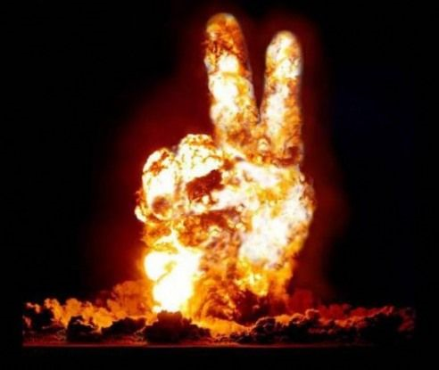
Causes of Violence
– Multi-factorial
  Stress
  Substance abuse
  Witnessing violence
  Disrespect
  Standing up for friends
  Neighborhood “Beef”

Slide 32
Re-injury Risk Factor
Substance abuse
School failure
Weapon possession
Poverty
Male gender
Black race
Gang involvement
Exposure to television violence
“Pain that is not transformed is transferred.” Richard Rohr

Slide 33
Non-fatal Violent Injury
Major cause of disability
94 nonfatal injuries for every homicidal death
Recurrent rates between 5% and 45% over the next 5 years subsequent to the initial injury involvement
“One who is injured ought not to return the injury, for on no account can it be right to do an injustice; and it is not right to return an injury, or to do evil to any man, however much we have suffered from him.” Socrates

Slide 34
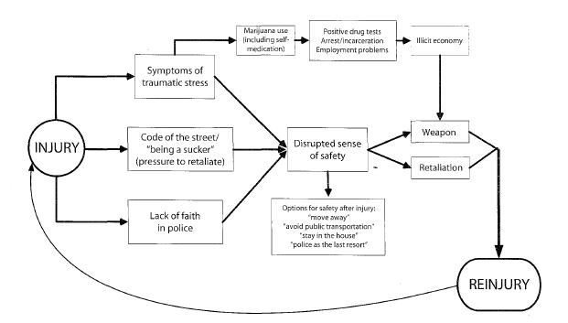
Pathways to Recurrence

Slide 35
Living and Surviving In a Multiply Wounded Country by Martha Cabrera
When one has a lot of accumulated pain, one loses the capacity to communicate with others. The ability to communicate, to be flexible and tolerant is enormously reduced among people who have a number of unresolved personal traumas. The characteristics vital to a person’s ability to function adequately become affected…
Multiply wounded societies run the risk of becoming societies with intergenerational traumas. It is virtually a law that one treats others the way one treats oneself. Anywhere that large population groups are traumatized, the trauma is transferred to the next generation. Working with the multiple wound phenomenon means accepting that the wounds are collective as well as personal…

Slide 36
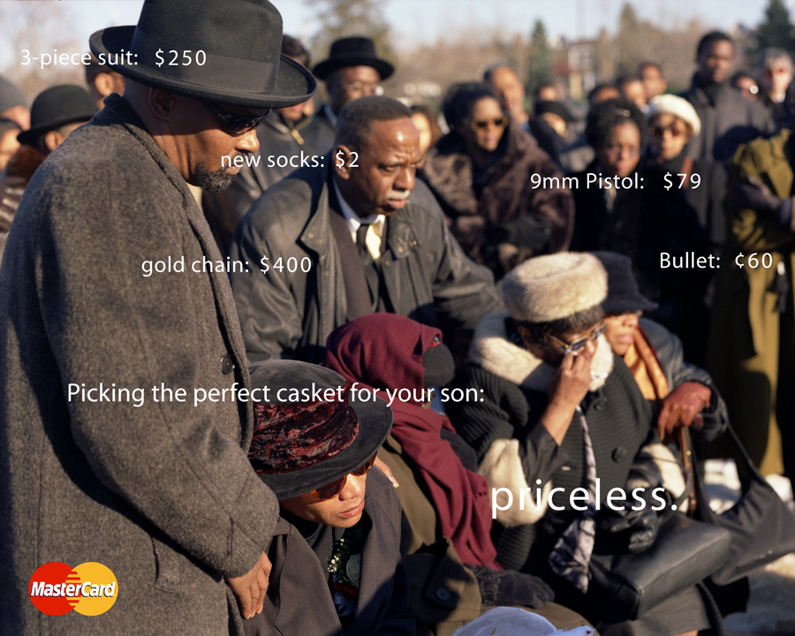

Slide 37
Case Study

Slide 38
Questions

Slide 39
Robert “Bob” Francis
781-848-1075
Robtfran@beld.net
Jacqueline “Jacque” Furtado
617-438-0451
furjacque@yahoo.com
Patricia “Pattie” Knight
617-919-3427
Patricia.knight@childrens.harvard.edu

Slide 40

Thank You !

